Slide 1


Performance Comparison
of Machine Learning Models
in Phishing Email Classification
Research Methodology Presentation
2802416141 - Nickholas Steven Sukmadjaja
Computer Science Department, Bina Nusantara University

Slide 2
Introduction: Problem and Research Objective
Problem
Real-world urgency
Research solution
Phishing emails deceive users into revealing credentials, financial data, or personal information.
Modern phishing messages increasingly resemble legitimate business communication.
Manual detection is difficult because attackers modify content, sender details, and embedded links.
Phishing remains a large-scale cybersecurity threat.
Before-the-click detection is important to reduce user exposure to malicious content.
Traditional blacklists and rule-based filtering can be bypassed by adaptive attacks.
Use machine learning to classify emails as Legitimate or Phishing.
Transform email body text using TF-IDF and add email length as a structural feature.
Compare Logistic Regression, SVM, Random Forest, Decision Tree, and Naive Bayes.
Evaluate performance using Accuracy, Precision, Recall, F1-score, and ROC-AUC.
Research aim: Determine which classical machine learning model performs best for phishing email classification.

Slide 3
Literature Review & Research Gap
What Prior Studies Show
Classic Machine Learning
Reseacrh Gap
Phishing email detection has shifted toward automated and data-driven approaches.
Feature extraction is central because email text must become numerical representation.
TF-IDF, word embeddings, and NLP-based features are frequently used.
Classical models are efficient, interpretable, and suitable for comparative classification tasks.
Traditional ML remains practical for resource-efficient phishing detection.
A clear comparison of widely used classical ML models is still valuable.
This study combines TF-IDF email body features with a simple structural feature: body_length.
The evaluation uses multiple metrics and visual diagnostics for model comparison.
Contribution: a practical, interpretable, and computationally efficient comparison of five ML models for phishing email classification.

Slide 4
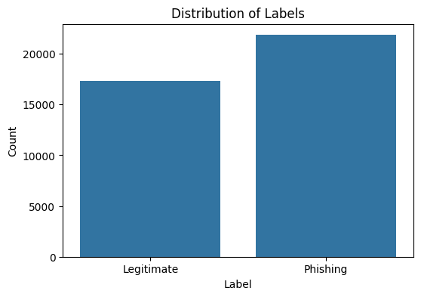
Dataset Description
CEAS 2008 Phishing Email Dataset
Original attributes
sender, receiver, date, subject, body, URLs, label
Selected variables
Feature
Description
Type
body
full email text
Text
label
0 = legitimate, 1 = phishing
Categorical
body_length
number of email characters
Numeric
Target label
Class distribution shows a slight imbalance with phishing emails as the majority class.
0 = Legitimate, 1 = Phising
5

Slide 5
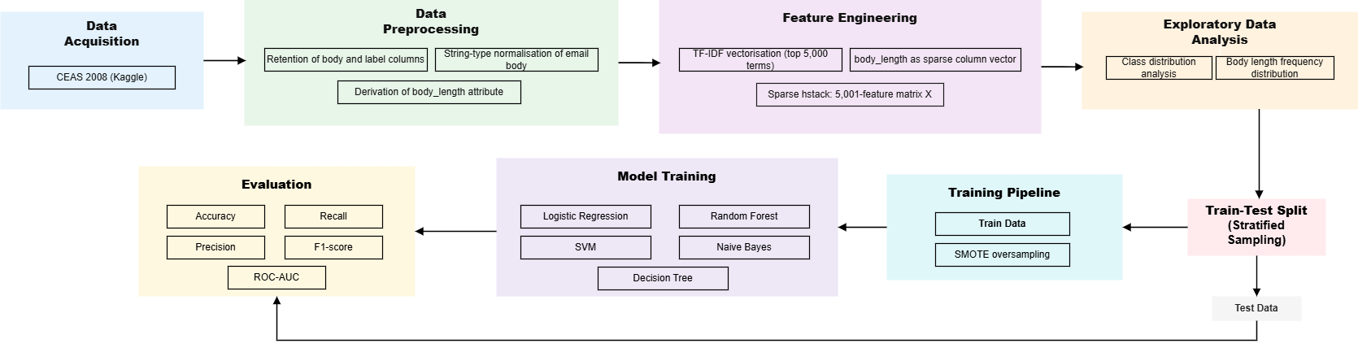
Research Workflow
The research workflow transforms raw email records into model-ready features, then evaluates five classifiers on unseen test data.
Key Principle
Evaluation Metric
SMOTE is applied only to the training set, while the test set remains unchanged for unbiased evaluation.
Accuracy, precision, recall, F1-score, ROC-AUC, ROC curve, and confusion matrix.
5

Slide 6
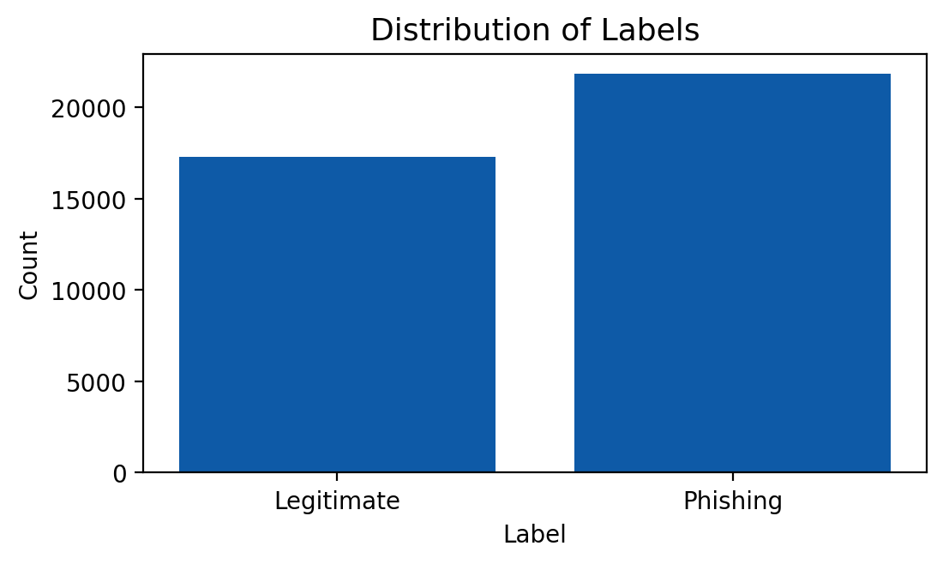
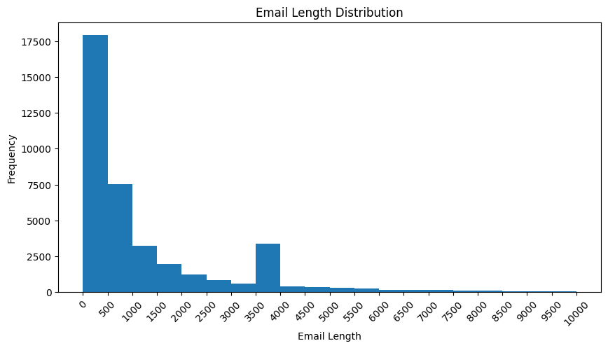
Exploratory Data Analysis
Label distribution
Email length distribution
The dataset has two target classes with a slight imbalance; phishing emails are the majority class.
Most emails are relatively short, while a small number have considerably longer content; this supports using body_length.
5

Slide 7
Feature Engineering
Email body was transformed using TF-IDF with the top 5,000 most informative terms.
body_length provides additional structural information.
The engineered body_length feature was added as a sparse column vector, producing 5,001 total features.

Slide 8
Experiment Setup
Five models were trained on the same feature matrix and evaluated using the same metrics.
Evaluated models
Evaluation metrics
Accuracy
Precision
Logistic Regression
Support Vector Machine (SVM)
Random Forest
Decision Tree
Naive Bayes
Recall
F1-score
ROC-AUC
Why recall matters
In phishing detection, missed phishing emails are risky. A high recall means the model detects most phishing emails correctly.

Slide 9
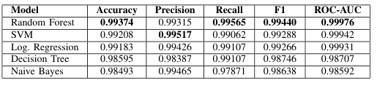
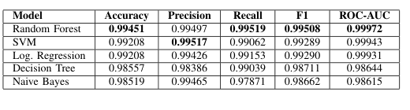
Overall Result
Adding body_length produced small improvements for several models, but the main predictive power still came from TF-IDF.
Before adding body_length
After adding body_length
Interpretation
Best Overall Model
Email length can support classification, especially for Random Forest, but it does not benefit every model equally.
Random Forest achieved the highest accuracy, recall, F1-score, and ROC-AUC.
Takeaway Key
Email length slightly improved Random Forest accuracy and F1-score, but the main predictive power still came from the TF-IDF representation of the email body.

Slide 10
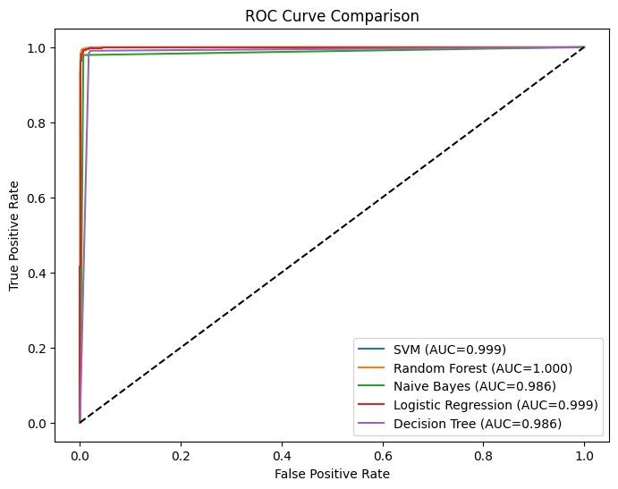
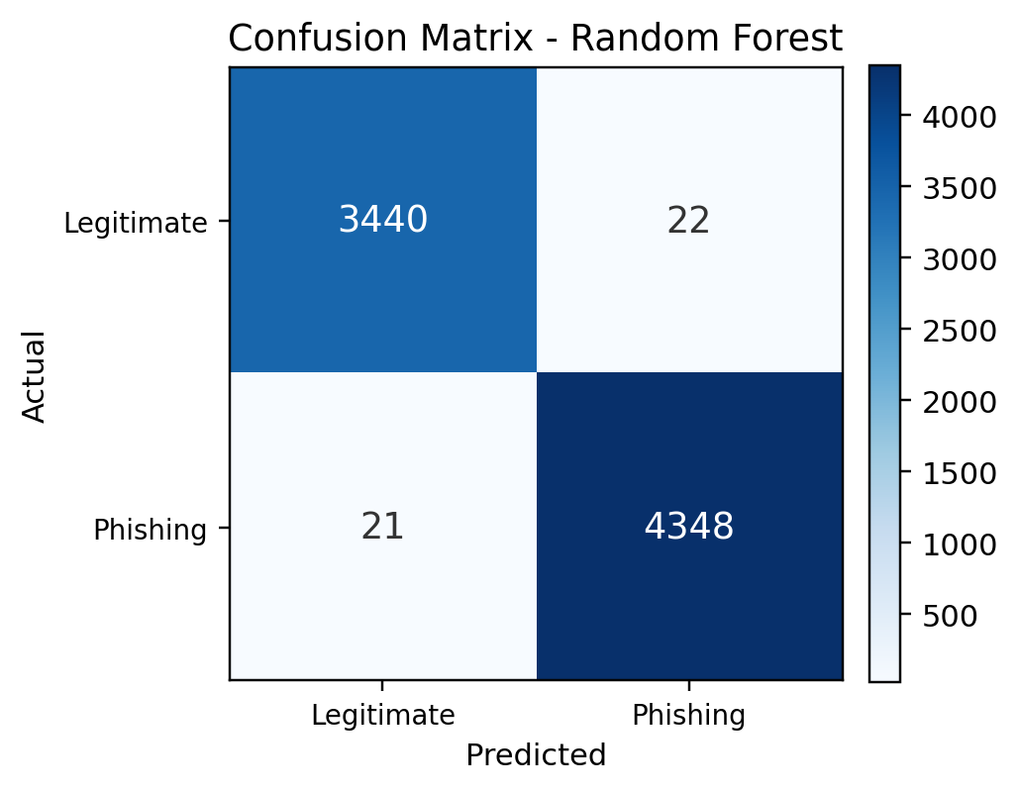
Best Model Diagnostic
ROC Curve Comparison
Confusion Matrix — Random Forest
Random Forest achieved the highest ROC-AUC, indicating strong discriminative ability across thresholds.
Random Forest produced only a small number of misclassifications: 22 false positives and 21 false negatives.

Slide 11
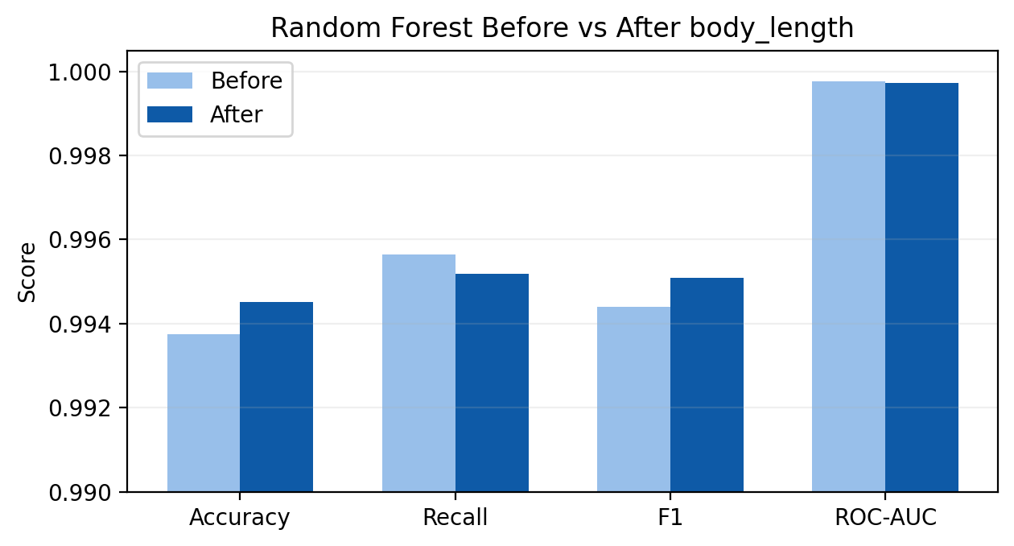
Impact of Feature Engineering
body_length provides additional structural information.
Random Forest shows a slight improvement in Accuracy and F1-score after adding the email length feature.
The improvement is small, meaning the main predictive power comes from TF-IDF text representation
Different models respond differently to the added structural feature.

Slide 12
Conclusion, Limitation & Future Work
Conclusion
Limitation
Future work
Machine learning can effectively classify phishing and legitimate emails.
Random Forest achieved the best overall performance across key metrics.
The experiment used only the CEAS08 dataset and focused mainly on email body text and email length. Sender, subject, URL, and temporal features were not fully explored.
Future studies can use newer datasets, richer metadata, URL-based features, and compare classical ML with deep learning or transformer-based models.
Takeaway Key
A simple and resource-efficient feature pipeline — TF-IDF + email length — can support highly effective phishing email classification when paired with a strong ensemble model.

Slide 13
Thank You
Performance Comparison of Machine Learning Models in Phishing Email Classification
2802416141 - Nickholas Steven Sukmadjaja
Computer Science Department, Bina Nusantara University

